Slide 1

Project Nova: Final Model Recommendations
August 26, 2025

Slide 2
Executive Summary
The baseline model provides a stable return of 12% with moderate risk.
Model performance is highly sensitive to how we handle data outliers; a more aggressive approach could boost returns to 13.5% but also increases risk.
Recommendation: We advise a final validation of the high-return alt_outlier scenario before full implementation.

Slide 3

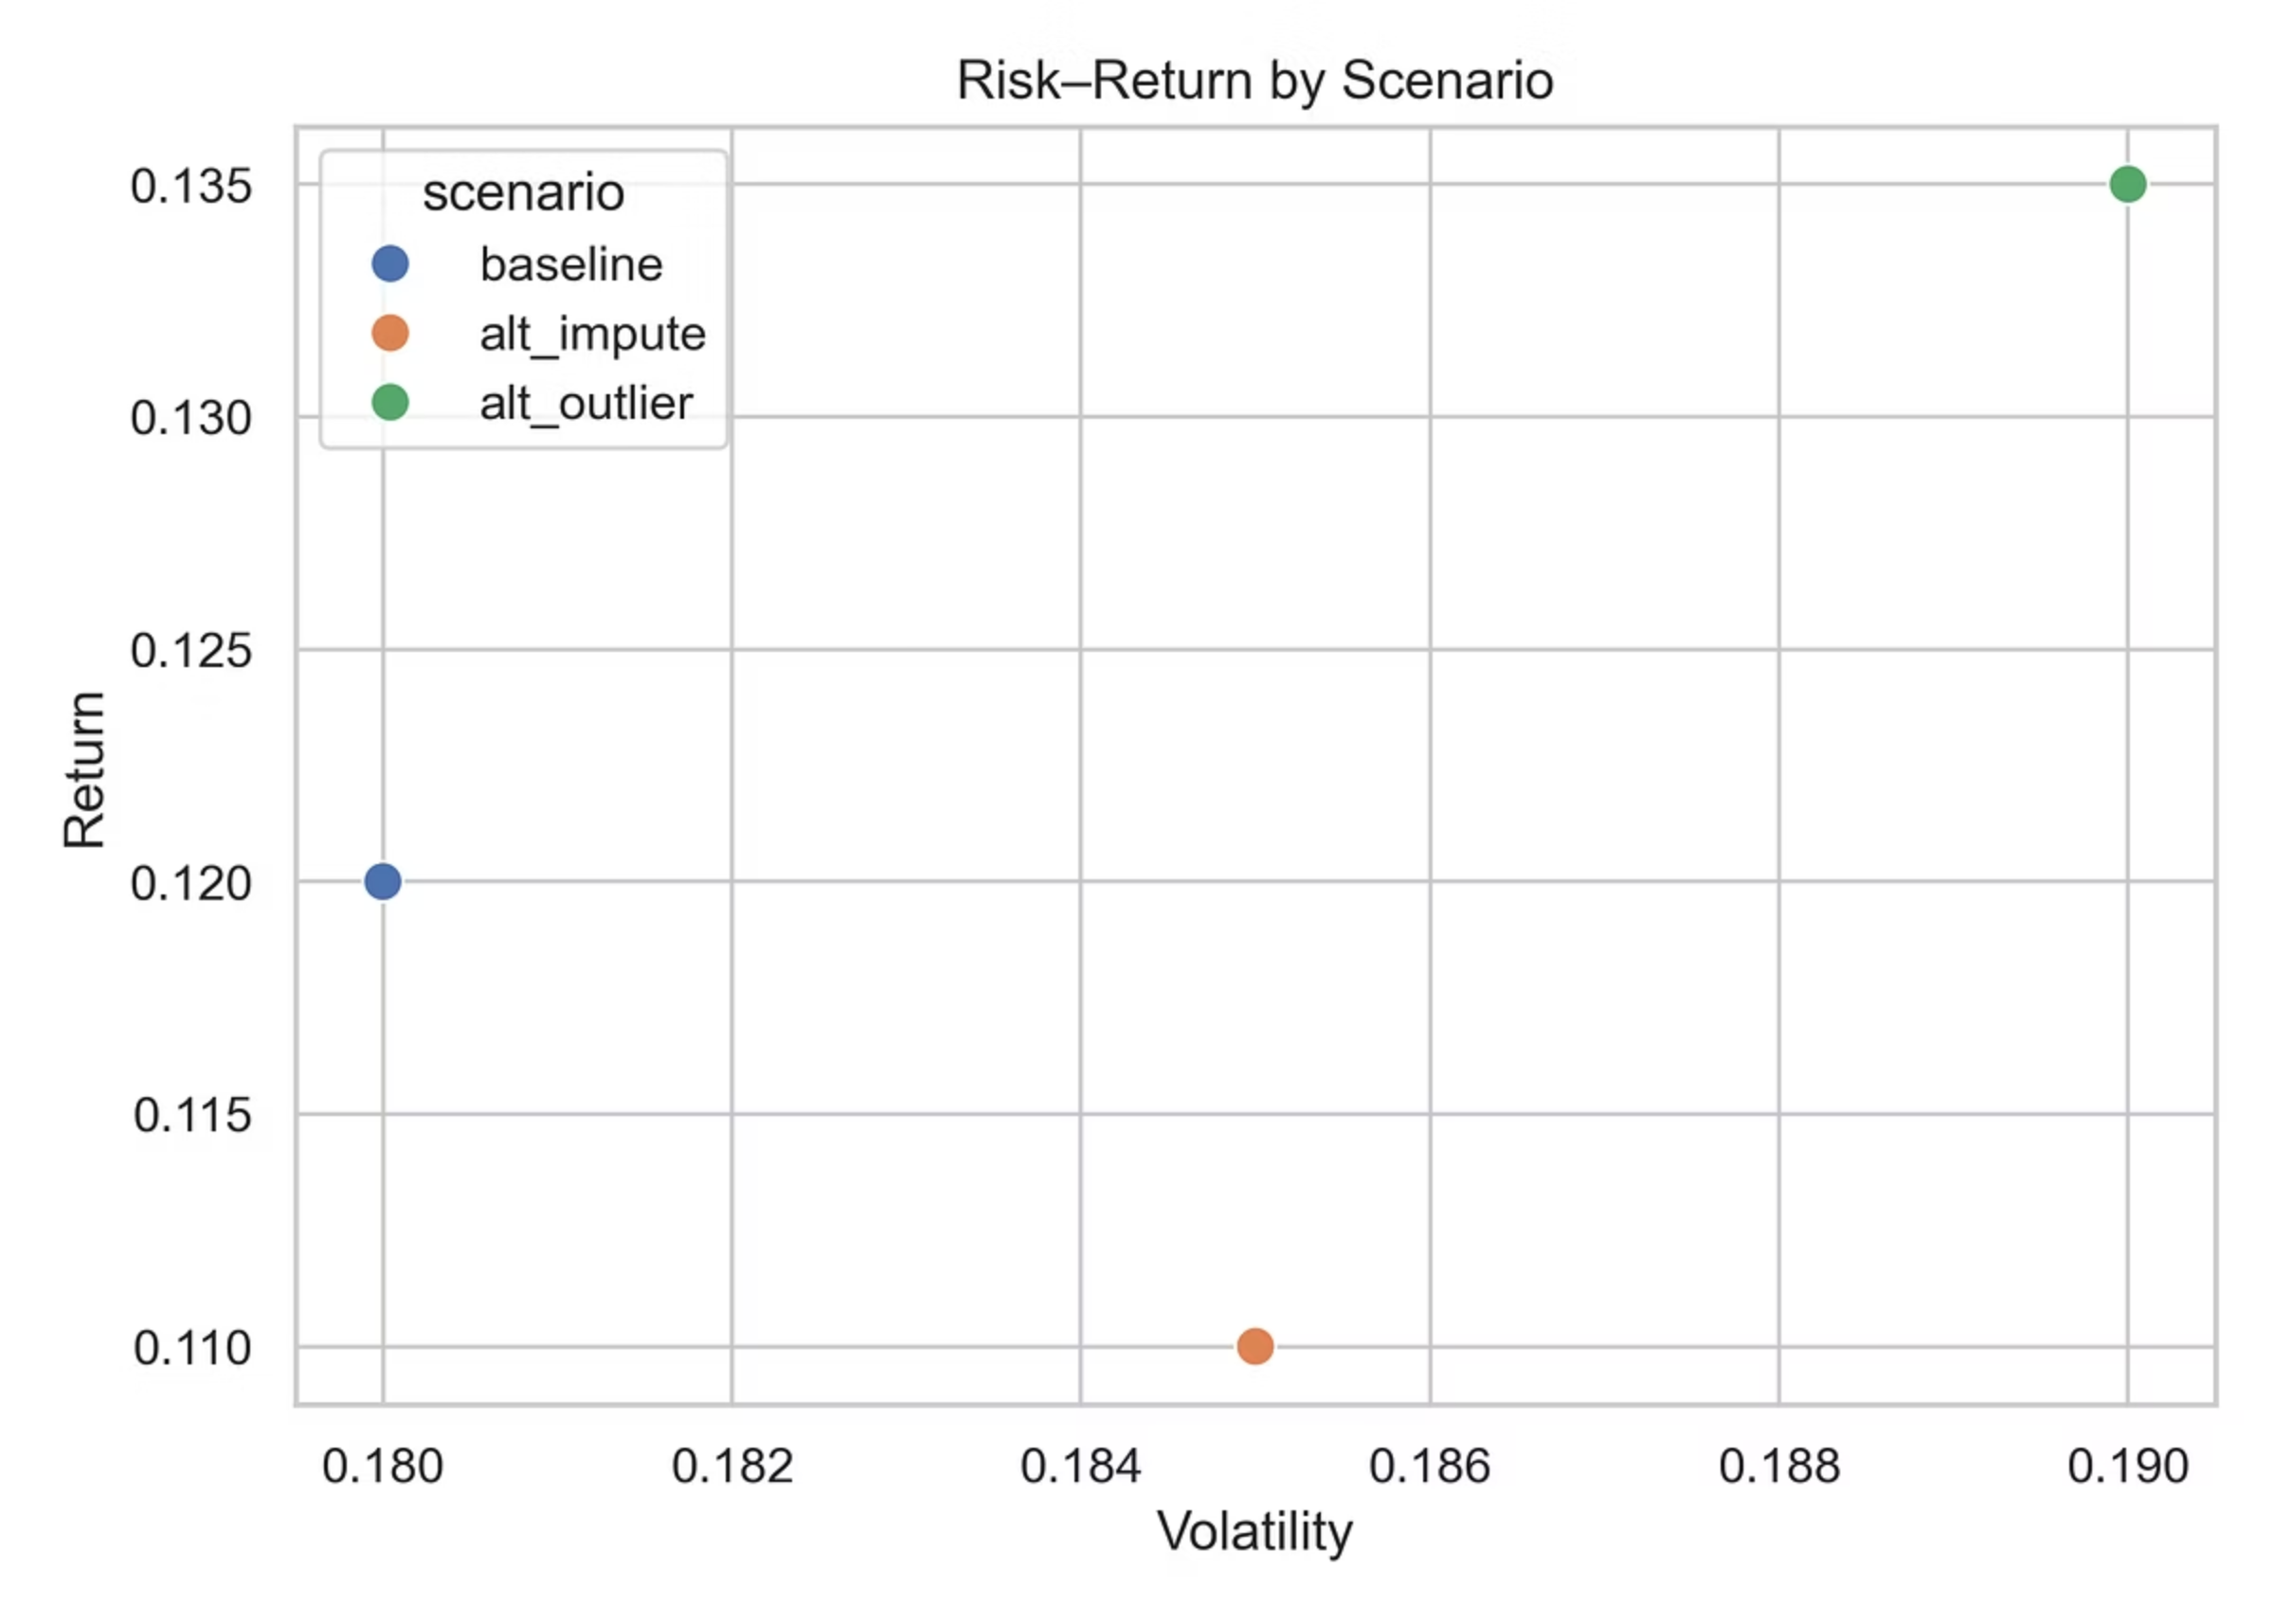
'Alternative Outlier' Scenario Offers Higher Returns at a Higher Risk
Takeaway:
The chart above maps each model scenario by its risk and return. The alt_outlier scenario (top right) stands out for its high potential return but is also the most volatile, representing a classic risk/reward tradeoff.

Slide 4

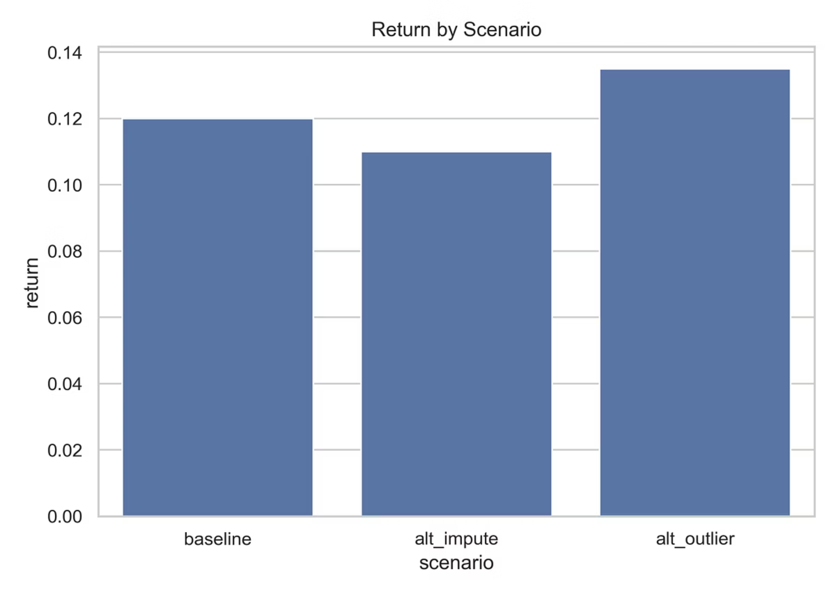
Outlier Handling is the Most Critical Assumption
Takeaway:
Changing how we fill missing data has a minor impact on our return forecast.
However, changing how we define and remove extreme data points has a major impact, significantly increasing expected returns.

Slide 5
Our Model Relies on Two Key Assumptions
Assumption 1: Filling Missing Data
Assumption 2: Removing Outliers
Method: We filled data gaps using the median value.
Method: We removed data points more than 3 standard deviations from the average.
Risk: Low impact. While this could slightly bias results if data gaps aren't random, sensitivity testing shows this risk is minimal.
Risk: High impact. This rule is the single biggest driver of our high-return scenario. If we are too aggressive, we could be overestimating returns and underestimating true risk.

Slide 6
What This Means
The choice is between a moderate-risk, moderate-return baseline model and a high-risk, high-return alt_outlier model.
The primary risk is whether the "outliers" we are removing are truly noise or are indicators of rare but important market events.

Slide 7
Recommended Next Steps
01
02
03
Authorize a deep dive:
Define risk tolerance:
Schedule a final review next week
Conduct a historical backtest of the alt_outlier scenario to see how it performs during market shocks.
Formally decide if a potential 1.5% return increase is worth the corresponding increase in volatility.
to discuss the backtest results and make a decision.

Slide 8

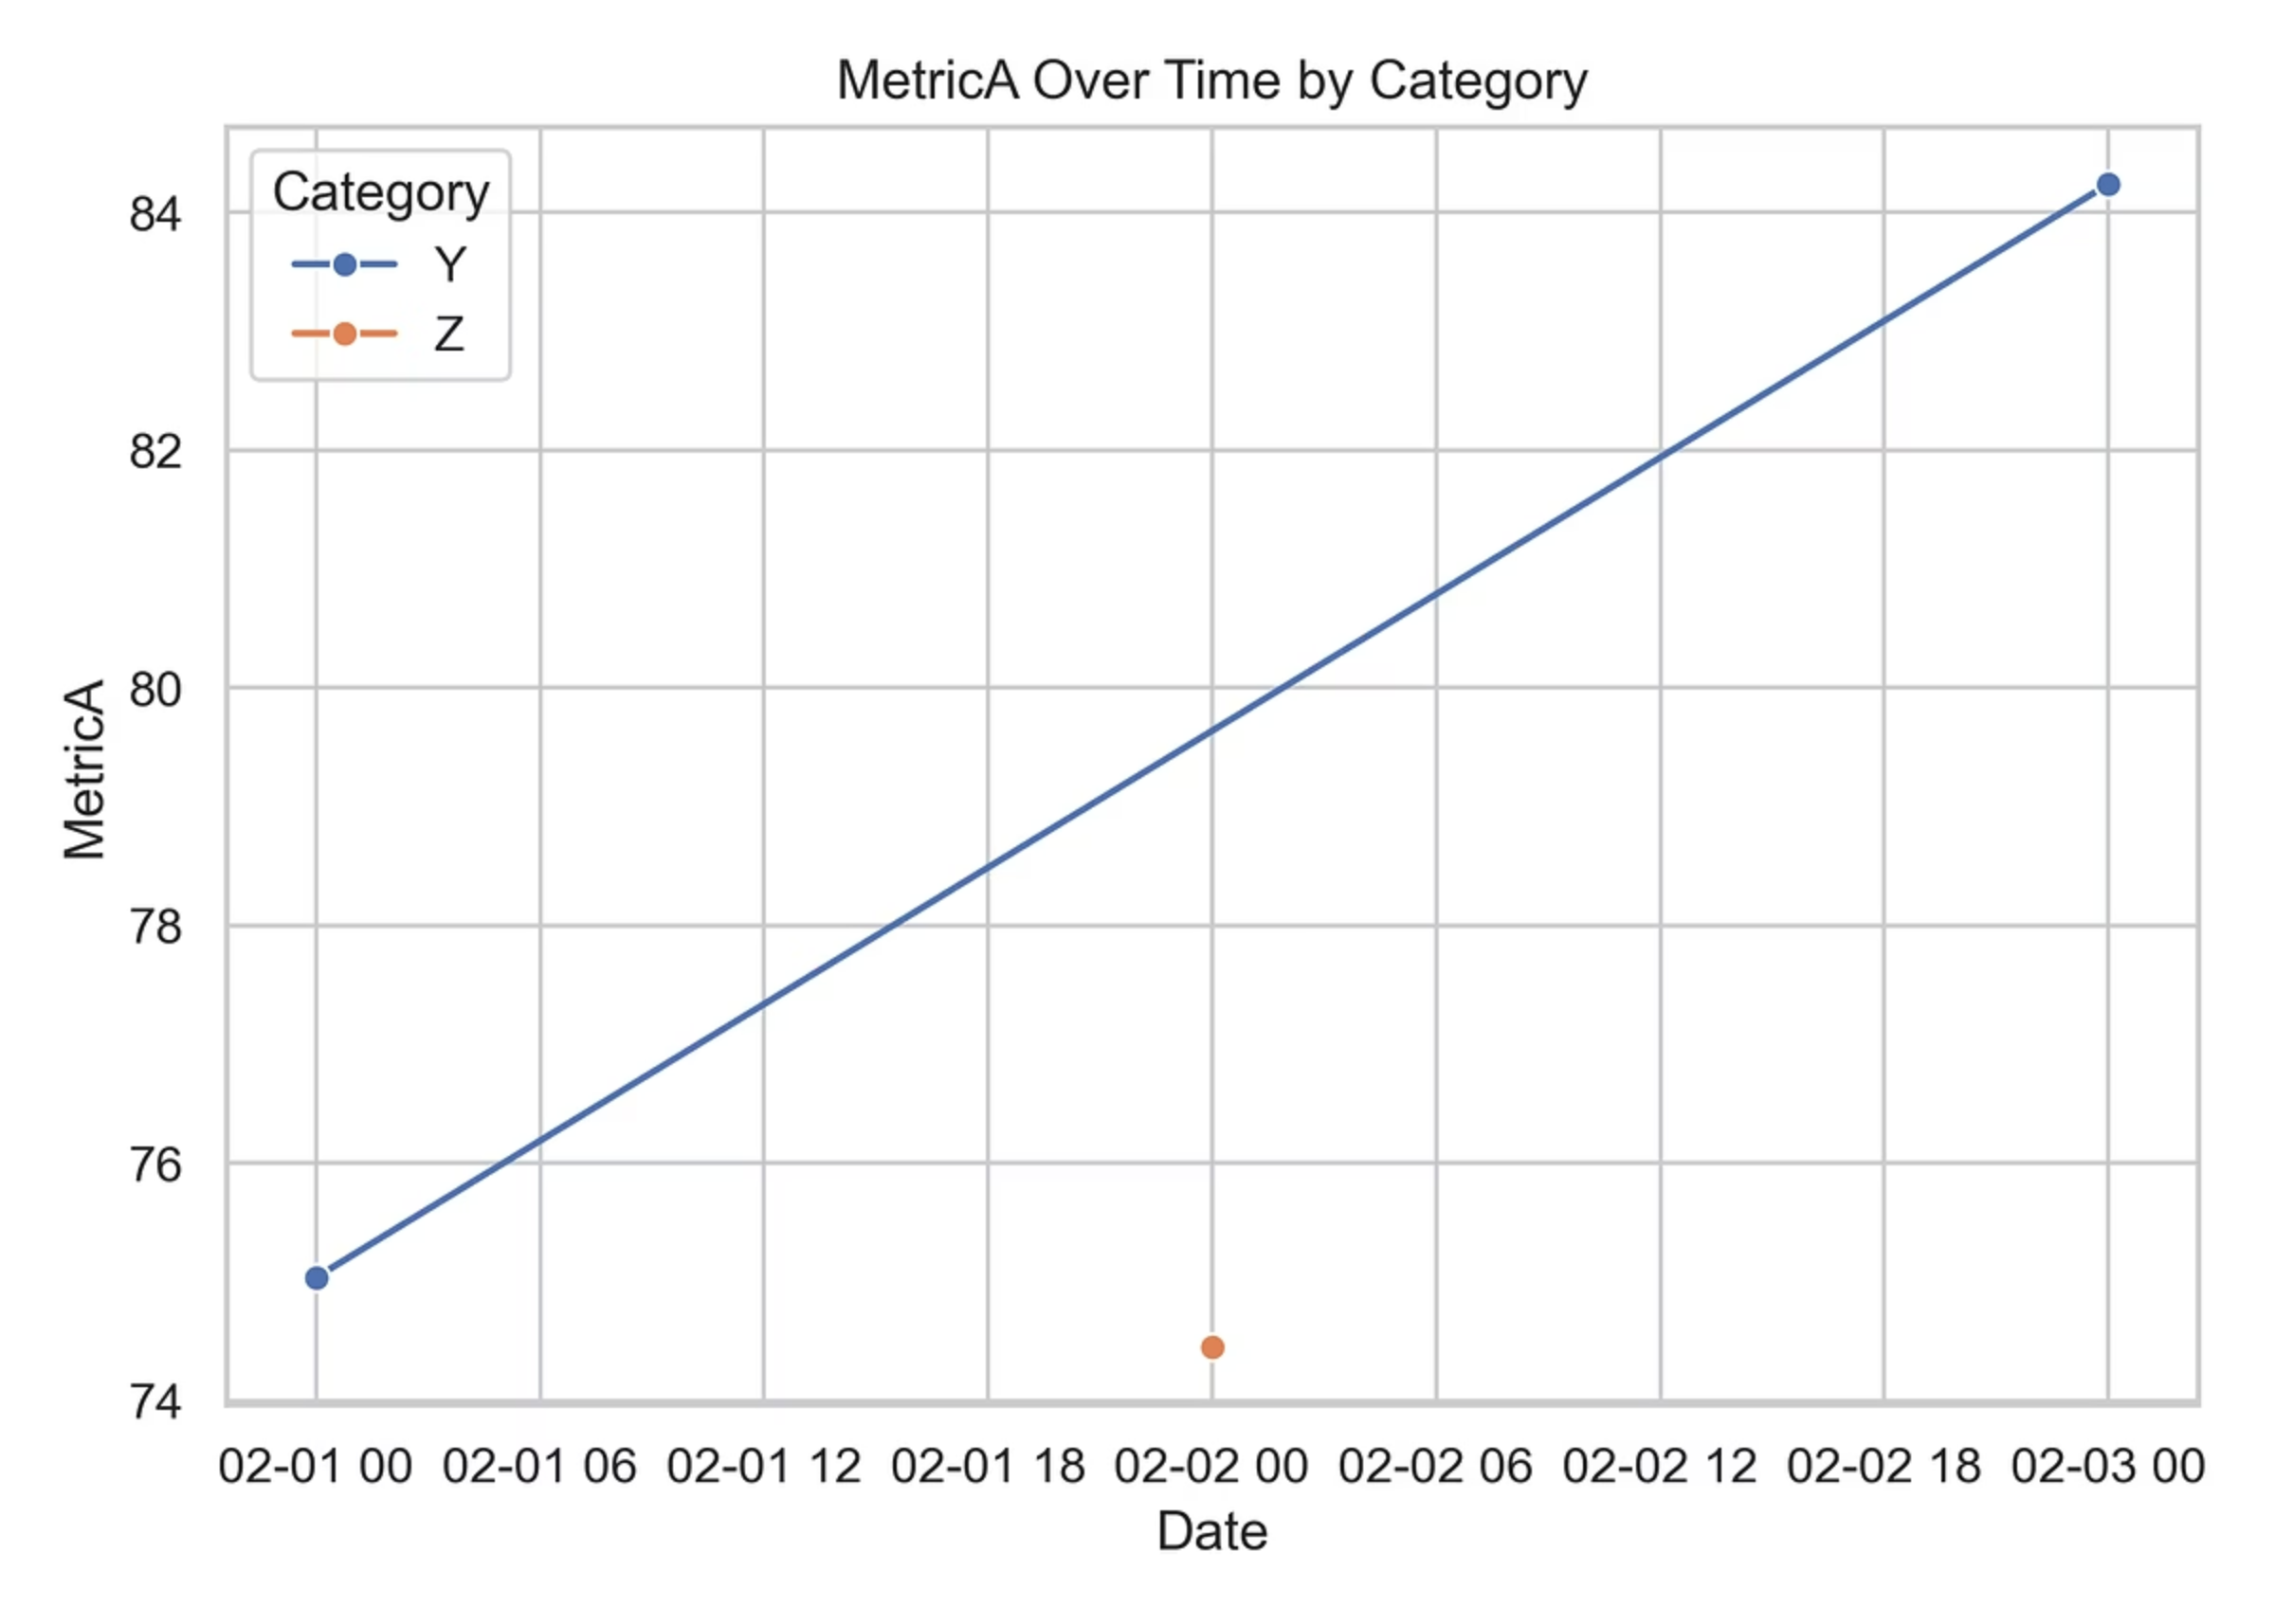
Sensitivity Analysis Summary
The impact of different assumptions on model outcomes.
This chart illustrates how outcomes change if assumptions change, specifically focusing on the impact of outlier handling over time.

Slide 9
Decision Implications: Risk vs. Reward
Baseline Model
Alt_Outlier Model
Moderate-risk
High-risk
Moderate-return
High-return
Stable 12% return
Potential 13.5% return
The core decision revolves around whether the increased return justifies the increased volatility and the risk of misinterpreting market events as noise.

Slide 10
Final Thoughts & Next Steps
We are at a critical juncture for Project Nova. The data clearly shows the potential for higher returns, but it comes with a calculated risk.
Your decision on risk tolerance will guide the final implementation strategy.
We look forward to discussing the backtest results and making a definitive decision next week.

